Slide 1
Living in a Network Centric World
Network Fundamentals – Chapter 1

Slide 2
Objectives
Describe how networks impact our daily lives.
Describe the role of data networking in the human network.
Identify the key components of any data network.
Identify the opportunities and challenges posed by converged networks.
Describe the characteristics of network architectures: fault tolerance, scalability, quality of service and security.

Slide 3
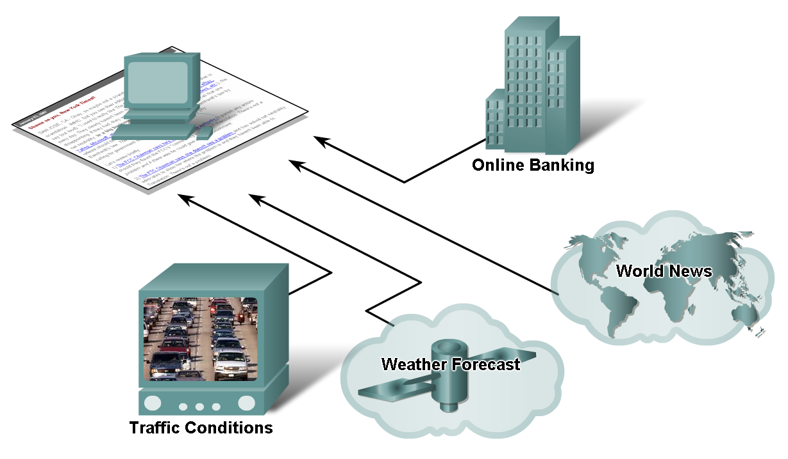
How Networks Impact Daily Life
Explain the benefits of instantaneous communication and how it supports and improves our lives.

Slide 4
Daily Life
Data networks that were once the transport of information from business to business have been repurposed to improve the quality of life for people everywhere. In the course of a day, resources available through the Internet can help you:
Decide what to wear using online current weather conditions.
Find the least congested route to your destination, displaying weather and traffic video from webcams.
Check your bank balance and pay bills electronically.
Receive and send e-mail, or make an Internet phone call, at an Internet cafe over lunch.
Obtain health information and nutritional advice from experts all over the world, and post to a forum to share related health or treatment information.
Download new recipes and cooking techniques to create a spectacular dinner.
Post and share your photographs, home videos, and experiences with friends or with the world

Slide 5
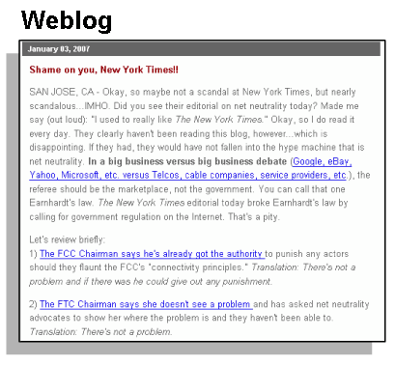

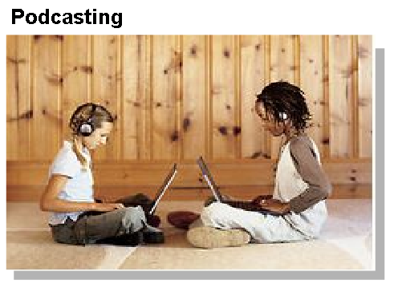
How Networks Impact Daily Life
Describe the characteristics and purpose of popular communication media such as, IM, Wikis , Blogs, Podcasting, and Collaboration Tools
  Instant messaging
    Real time communication
    between 2 or more
    people based on typed text
  Weblogs (Blogs)
    Web pages created
    by an individual
  Podcasting
    Website that contains
    audio files available
    for downloading

Slide 6
Communication Tools
Instant Messaging
In IM tools, the text is conveyed via computers connected over either a private internal network or over a public network, such as the Internet.
Like e-mail, IM sends a written record of the communication. However, whereas transmission of e-mail messages is sometimes delayed, IM messages are received immediately.
The form of communication that IM uses is called real-time communication.
Pod Casting
Podcasting is an audio-based medium that originally enabled people to record audio and convert it for use with iPods - a small, portable device for audio playback manufactured by Apple.
The ability to record audio and save it to a computer file is not new. However, podcasting allows people to deliver their recordings to a wide audience.
The audio file is placed on a website (or blog or wiki) where others can download it and play the recording on their computers, laptops, and iPods.

Slide 7
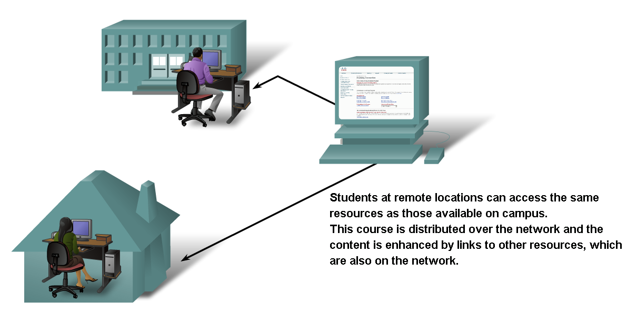
How Networks Impact Daily Life
Explain ways that using information networks to share and collaborate improves teaching and learning

Slide 8
Increasing your learning experience
The Cisco Networking Academy Program, which offers this course, is an example of a global online learning experience.
The instructor provides a syllabus and establishes a preliminary schedule for completing the course content. The Academy program supplements the expertise of the instructor with an interactive curriculum that provides many forms of learning experiences.
The program provides text, graphics, animations, and a simulated networking environment tool called Packet Tracer. Packet Tracer provides a way to build virtual representations of networks and emulate many of the functions of networking devices.
Students may communicate with the instructor and fellow students using online tools, like e-mail, bulletin/discussion boards, chat rooms, and instant messaging.
Links provide access to learning resources outside of the courseware. Blended e-learning provides the benefits of computer-based training while retaining advantages of instructor-led curriculum.
Students have the opportunity to work online at their own pace and skill level while still having access to an instructor and other live resources.

Slide 9
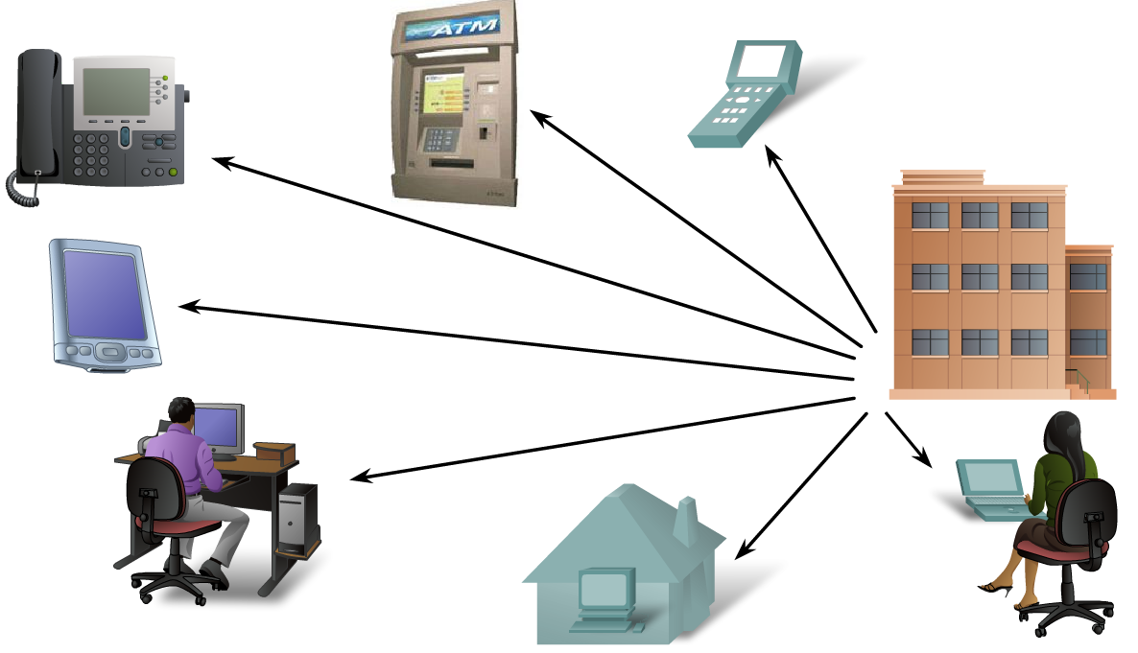
How Networks Impact Daily Life
Describe ways communication over a network changes the way we work

Slide 10
Intranet & Extranets
Initially, data networks were used by businesses to internally record and manage financial information, customer information, and employee payroll systems.
These business networks evolved to enable the transmission of many different types of information services, including e-mail, video, messaging, and telephony.
Intranets, private networks in use by just one company, enable businesses to communicate and perform transactions among global employee and branch locations. Companies develop extranets, or extended internetworks, to provide suppliers, vendors, and customers limited access to corporate data to check order status, inventory, and parts lists.
Today, networks provide a greater integration between related functions and organizations than was possible in the past.

Slide 11
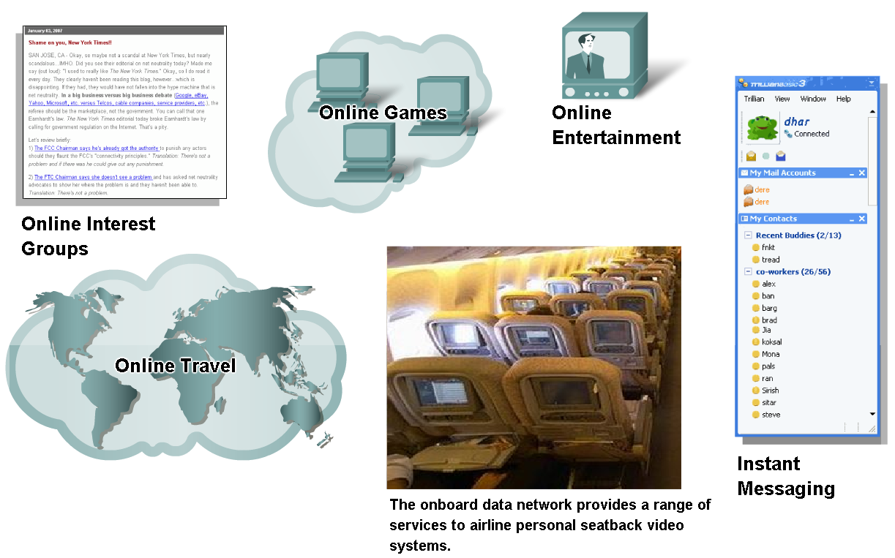
How Networks Impact Daily Life
Describe ways communication over a network supports the way we play

Slide 12
How we Play
The widespread adoption of the Internet by the entertainment and travel industries enhances the ability to enjoy and share many forms of recreation, regardless of location.
The Internet is used for traditional forms of entertainment, as well. We listen to recording artists, preview or view motion pictures, read entire books and download material for future offline access.
Networks enable the creation of new forms of entertainment, such as online games.
Even offline activities are enhanced using network collaboration services. Global communities of interest have grown rapidly
Online markets and auction sites provide the opportunity to buy, sell and trade all types of merchandise.
Whatever form of recreation we enjoy in the human network, networks are improving our experience.

Slide 13
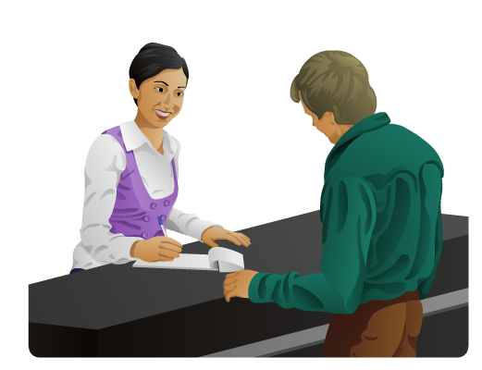
Data Networking Role, Components, and Challenges
Basic characteristics of communication
  Rules or agreements are 1st established
  Important information may need to be repeated
  Various modes of communication may impact the effectiveness of getting the message across.

Slide 14
Establishing the Rules
Before beginning to communicate with each other, we establish rules or agreements to govern the conversation. These rules, or protocols, must be followed in order for the message to be successfully delivered and understood.
Among the protocols that govern successful human communication are:
An identified sender and receiver
Agreed upon method of communicating (face-to-face, telephone, letter, photograph)
Common language and grammar
Speed and timing of delivery
Confirmation or acknowledgement requirements
For data networks, we use the same basic criteria to judge success. However, as a message moves through the network, many factors can prevent the message from reaching the recipient or distort its intended meaning. These factors can be either external or internal.

Slide 15
External Factors
The external factors affecting communication are related to the complexity of the network and the number of devices a message must pass through on its route to its final destination.
External factors affecting the success of communication include:
The quality of the pathway between the sender and the recipient
The number of times the message has to change form
The number of times the message has to be redirected or readdressed
The number of other messages being transmitted simultaneously on the communication network
The amount of time allotted for successful communication

Slide 16
Internal Factors
Internal factors that interfere with network communication are related to the nature of the message itself.
Different types of messages may vary in complexity and importance. Clear and concise messages are usually easier to understand than complex messages.
Important communications require more care to ensure that they are delivered and understood by the recipient.
Internal factors affecting the successful communication across the network include:
The size of the message
The complexity of the message
The importance of the message

Slide 17
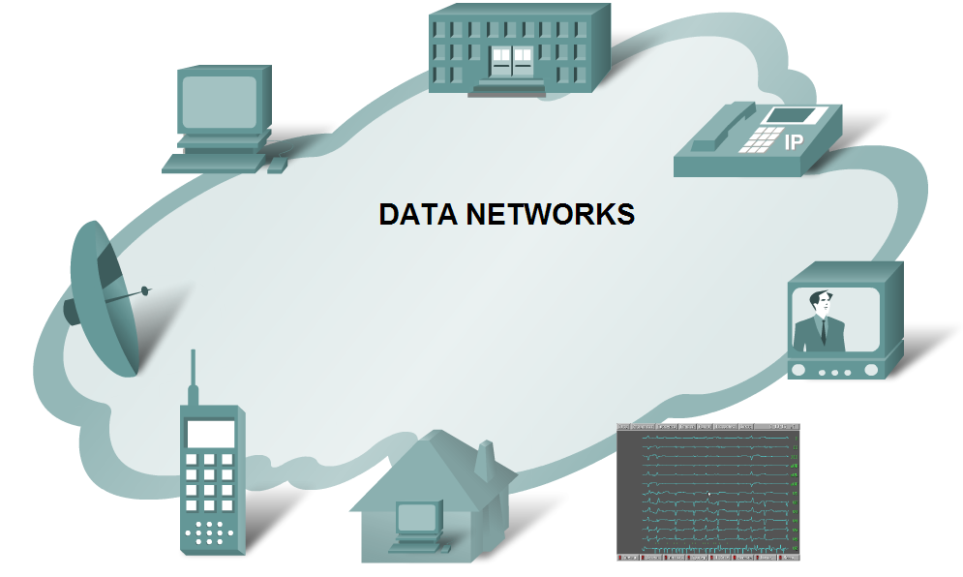
Data Networking Role, Components, and Challenges
Describe the role of data networking in communications

Slide 18
Communicating Over Networks
Data or information networks vary in size and capabilities, but all networks have four basic elements in common:
Rules or agreements to govern how the messages are sent, directed, received and interpreted
The messages or units of information that travel from one device to another
A means of interconnecting these devices - a medium that can transport the messages from one device to another
Devices on the network that exchange messages with each other
The standardization of the various elements of the network enables equipment and devices created by different companies to work together.

Slide 19
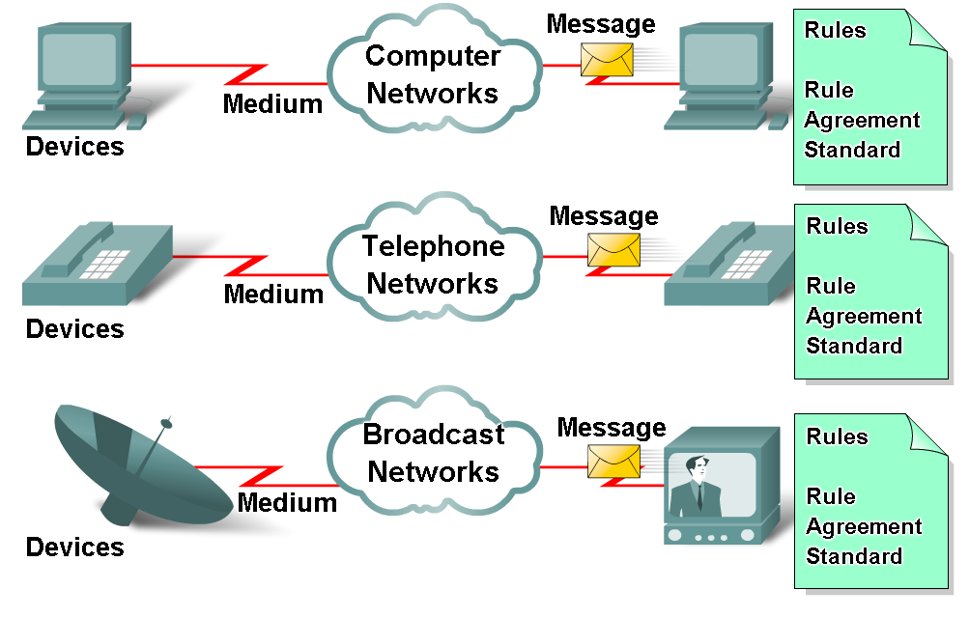
Data Networking Role, Components, and Challenges
Describe the various elements that make up a network
  Devices
    These are used to communicate with one another
  Medium
    This is how the devices are connected together
  Messages
    Information that travels over the medium
  Rules
    Governs how messages flow across network

Slide 20
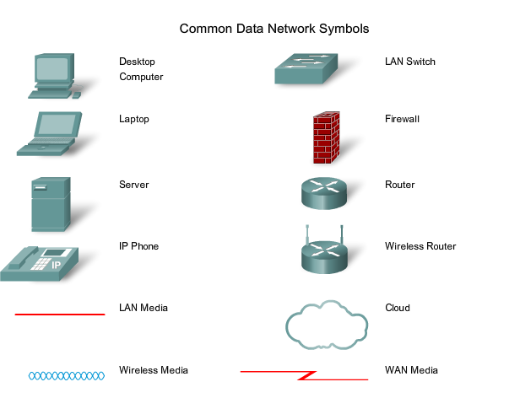
Symbols

Slide 21
Network Connections
For a network to function, the devices must be interconnected. Network connections can be wired or wireless.
In wired connections, the medium is either copper, which carries electrical signals, or optical fiber, which carries light signals. In wireless connections, the medium is the Earth's atmosphere, or space, and the signals are microwaves.
Copper medium includes cables, such as twisted pair telephone wire, coaxial cable, or most commonly, what is known as Category 5 Unshielded Twisted Pair (UTP) cable.
Optical fibres, thin strands of glass or plastic that carry light signals, are another form of networking media.
Wireless media may include the home wireless connection between a wireless router and a computer with a wireless network card, the terrestrial wireless connection between two ground stations, or the communication between devices on earth and satellites. In a typical journey across the Internet, a message may travel across a variety of media.

Slide 22
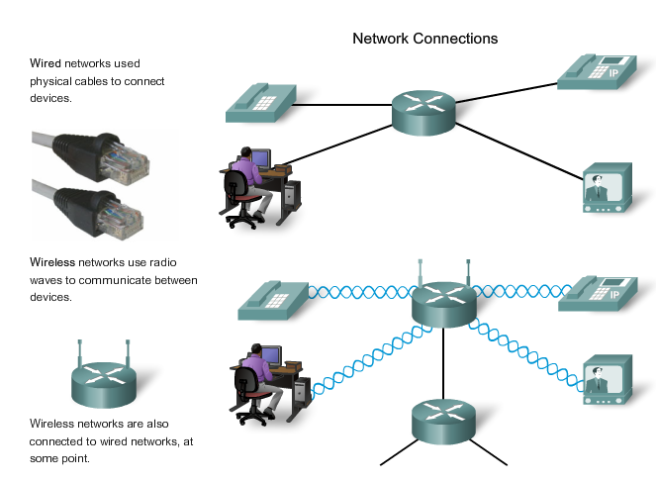
Connections Identified

Slide 23
Elements of a Network
Protocols are the rules that the networked devices use to communicate with each other.
The industry standard in networking today is a set of protocols called TCP/IP (Transmission Control Protocol/Internet Protocol). TCP/IP is used in home and business networks, as well as being the primary protocol of the Internet.
It is TCP/IP protocols that specify the formatting, addressing and routing mechanisms that ensure our messages are delivered to the correct recipient.
There are 5 main elements in the network;
The messages
The devices
The medium
The services
The rules

Slide 24
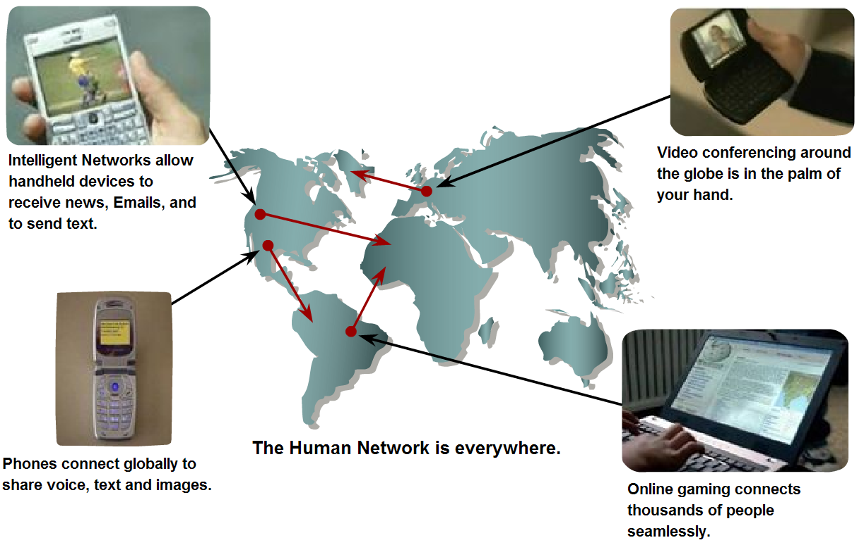
Data Networking Role, Components, and Challenges
Describe the role of converged networks in communications
  Converged network
    A type of network that can carry voice, video & data over the same network

Slide 25
Multiple services-multiple networks
Traditional telephone, radio, television, and computer data networks each have their own individual versions of the four basic network elements.
In the past, every one of these services required a different technology to carry its particular communication signal. Additionally, each service had its own set of rules and standards to ensure successful communication of its signal across a specific medium.
Converged Networks
Technology advances are enabling us to consolidate these disparate networks onto one platform - a platform defined as a converged network.
The flow of voice, video, and data traveling over the same network eliminates the need to create and maintain separate networks.
On a converged network there are still many points of contact and many specialized devices - for example, personal computers, phones, TVs, personal assistants, and retail point-of-sale registers - but only one common network infrastructure.

Slide 26
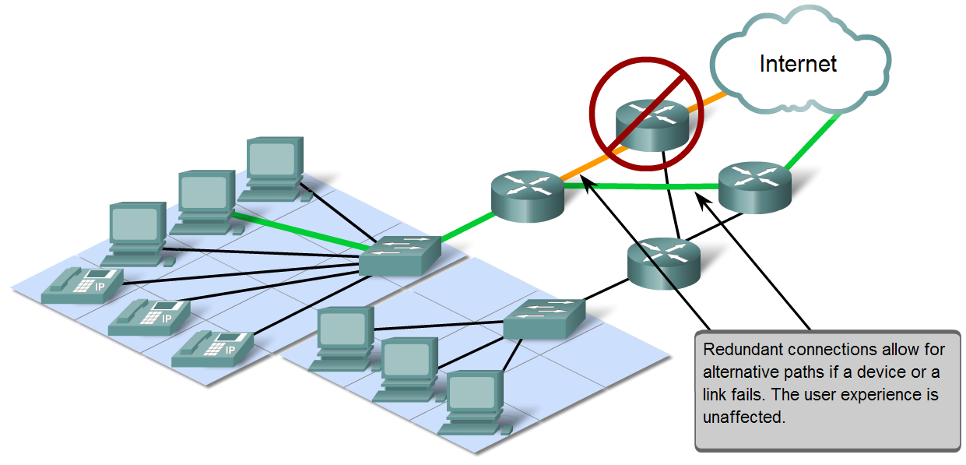
Network Architecture Characteristics
Explain four characteristics that are addressed by network architecture design
  Fault tolerance
  Scalability
  Quality of service
  Security

Slide 27
Fault Tolerance
The expectation that the Internet is always available to the millions of users who rely on it requires a network architecture that is designed and built to be fault tolerant.
A fault tolerant network is one that limits the impact of a hardware or software failure and can recover quickly when such a failure occurs.
These networks depend on redundant links, or paths, between the source and destination of a message.
If one link or path fails, processes ensure that messages can be instantly routed over a different link transparent to the users on either end.
Both the physical infrastructures and the logical processes that direct the messages through the network are designed to accommodate this redundancy. This is a basic premise of the architecture of current networks.

Slide 28
Scalability
A scalable network can expand quickly to support new users and applications without impacting the performance of the service being delivered to existing users.
Thousands of new users and service providers connect to the Internet each week. The ability of the network to support these new interconnections depends on a hierarchical layered design for the underlying physical infrastructure and logical architecture.
The operation at each layer enables users or service providers to be inserted without causing disruption to the entire network.
Technology developments are constantly increasing the message carrying capabilities and performance of the physical infrastructure components at every layer.
These developments, along with new methods to identify and locate individual users within an internetwork, are enabling the Internet to keep pace with user demand.

Slide 29
QoS – Quality of Service
The Internet is currently providing an acceptable level of fault tolerance and scalability for its users.
But new applications available to users over internetworks create higher expectations for the quality of the delivered services.
Voice and live video transmissions require a level of consistent quality and uninterrupted delivery that was not necessary for traditional computer applications.
Quality of these services is measured against the quality of experiencing the same audio or video presentation in person.
Traditional voice and video networks are designed to support a single type of transmission, and are therefore able to produce an acceptable level of quality.
New requirements to support this quality of service over a converged network are changing the way network architectures are designed and implemented.

Slide 30
Security
The Internet has evolved from a tightly controlled internetwork of educational and government organizations to a widely accessible means for transmission of business and personal communications.
As a result, the security requirements of the network have changed.
The security and privacy expectations that result from the use of internetworks to exchange confidential and business critical information exceed what the current architecture can deliver.
Rapid expansion in communication areas that were not served by traditional data networks is increasing the need to embed security into the network architecture.
As a result, much effort is being devoted to this area of research and development. In the meantime, many tools and procedures are being implemented to combat inherent security flaws in the network architecture.

Slide 31
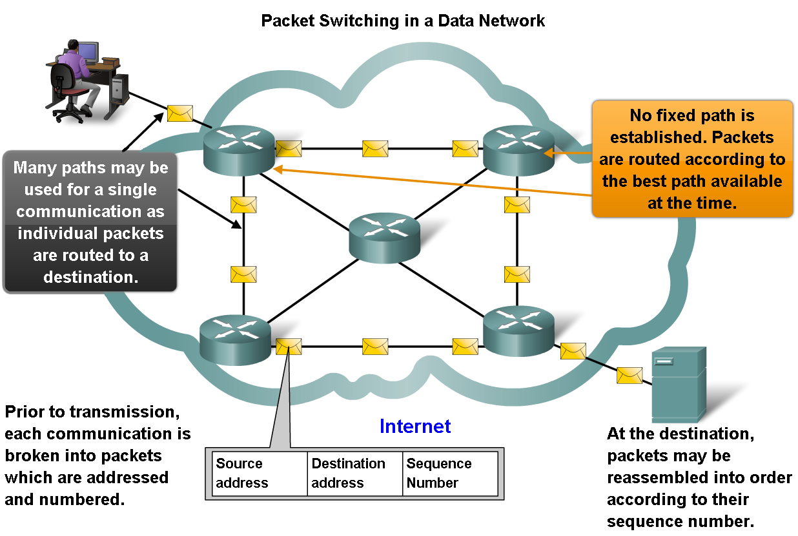
Network Architecture Characteristics
Describe how packet switching helps improve the resiliency and fault tolerance of the Internet architecture

Slide 32
Circuit Switched Technology
Represents a typical telephone switching network where a call from a sender to receiver is switched from location to location.
This type of connection-oriented network is called a circuit-switched network.
Many circuit switched networks give priority to maintaining existing circuit connections, at the expense of new circuit requests.
In this type of connection-oriented network, once a circuit is established, even if no communication is occurring between the persons on either end of the call, the circuit remains connected and resources reserved until one of the parties disconnects the call.

Slide 33
Packet Switched Technology
In the search for a network that could withstand the loss of a significant amount of its transmission and switching facilities, the early Internet designers re-evaluated early research regarding packet switched networks.
The premise for this type of networks is that a single message can be broken into multiple message blocks. Individual blocks containing addressing information indicate both their origination point and their final destination.
Using this embedded information, these message blocks, called packets, can be sent through the network along various paths, and can be reassembled into the original message upon reaching their destination.
By providing a method to dynamically use redundant paths, without intervention by the user, the Internet has become a fault tolerant, scalable method of communications.

Slide 34
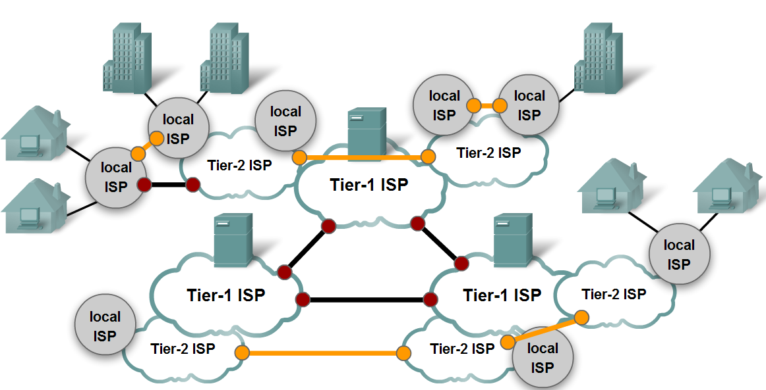
Network Architecture Characteristics
Describe characteristics of the Internet that help it scale to meet user demand
  Hierarchical
  Common standards
  Common protocols

Slide 35
Scalability
The fact that the Internet is able to expand at the rate that it is, without seriously impacting the performance experienced by individual users, is a function of the design of the protocols and underlying technologies on which it is built.
The Internet, which is actually a collection of interconnected private and public networks, has a hierarchical layered structure for addressing, for naming and for connectivity services.
At each level or layer of the hierarchy, individual network operators maintain peering relationships with other operators at the same level.
As a result, network traffic that is destined for local or regional services does not need to traverse to a central point for distribution.
Common services can be duplicated in different regions, thereby keeping traffic off the higher level backbone networks.

Slide 36
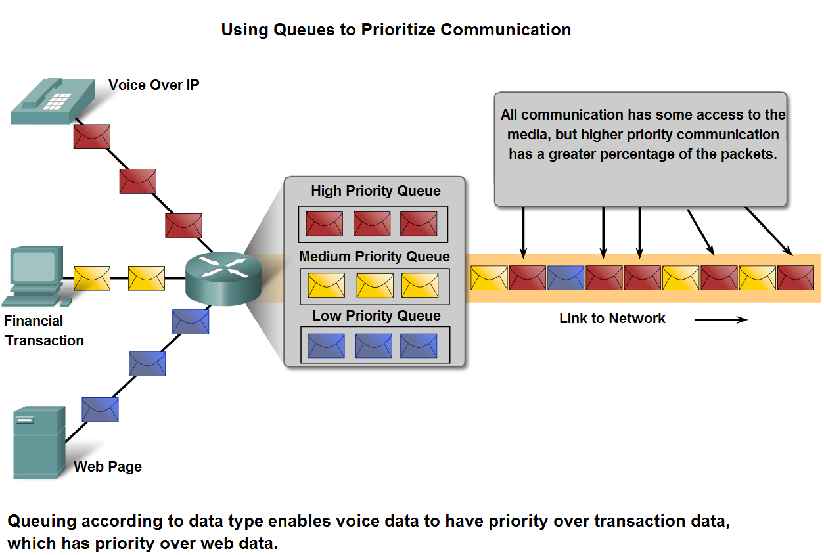
Network Architecture Characteristics
Explain the factors that necessitate Quality of Service and the mechanisms necessary to ensure it

Slide 37
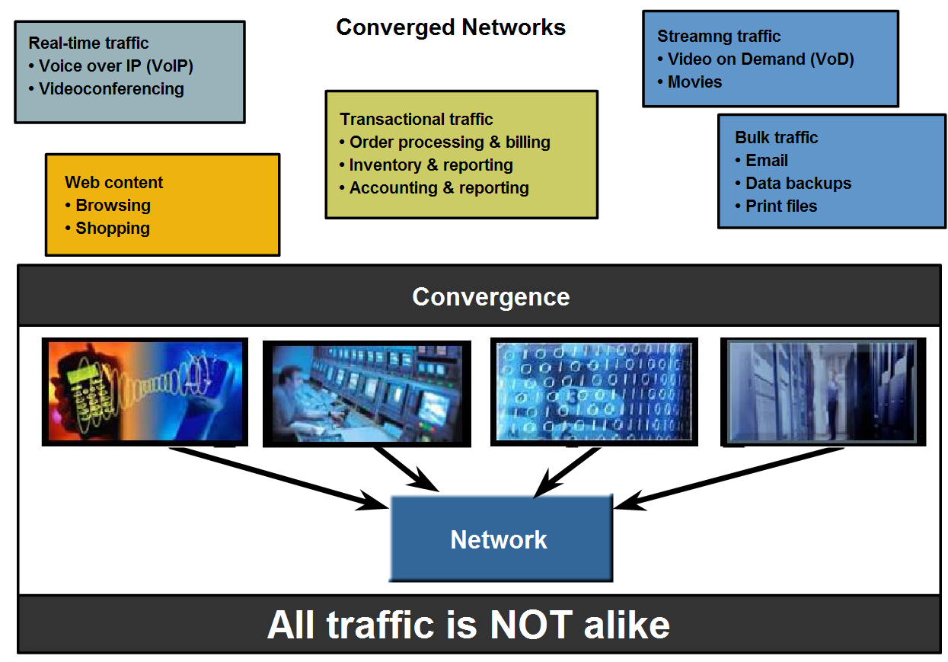
Network Architecture Characteristics
Describe how QoS mechanisms work to ensure quality of service for applications that require it.

Slide 38
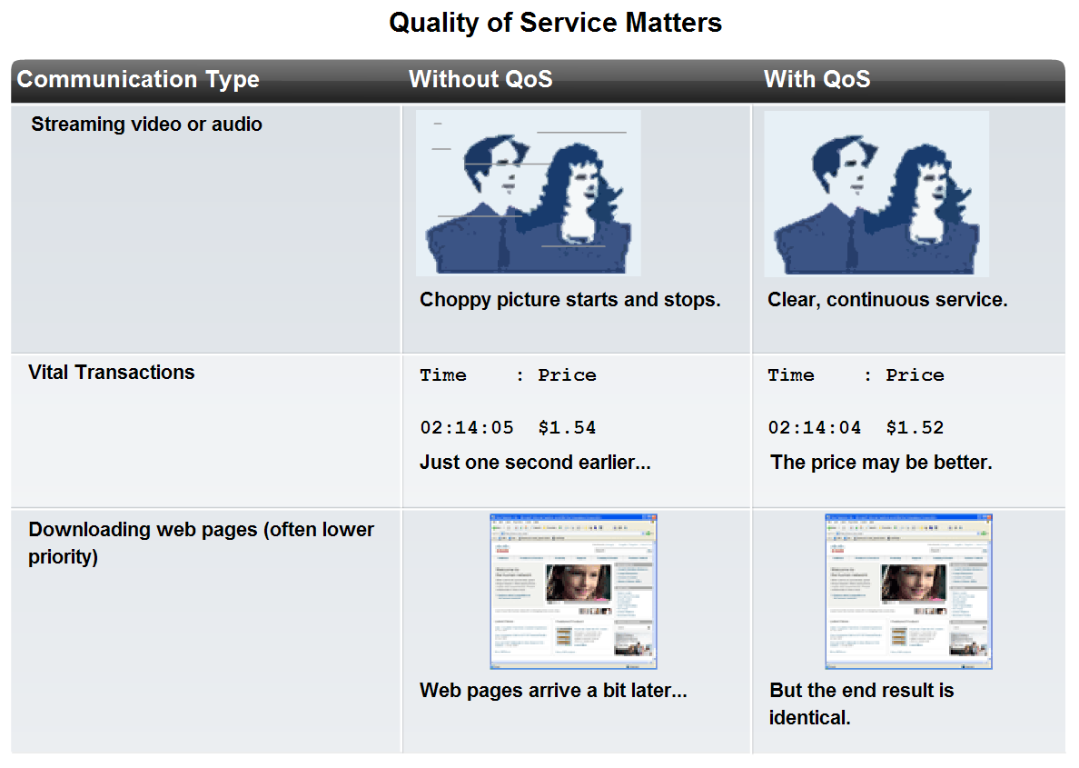
Network Architecture Characteristics
Describe how to select the appropriate QoS strategy for a given type of traffic

Slide 39
QoS Mechanisms
QoS mechanisms enable the establishment of queue management strategies that enforce priorities for different classifications of application data. Without properly designed and implemented QoS mechanisms, data packets will be dropped without consideration of the application characteristics or priority. Examples of priority decisions for an organization might include:
Time-sensitive communication - increase priority for services like telephony or video distribution.
Non time-sensitive communication - decrease priority for web page retrieval or e-mail.
High importance to organization - increase priority for production control or business transaction data.
Undesirable communication - decrease priority or block unwanted activity, like peer-to-peer file sharing or live entertainment.

Slide 40
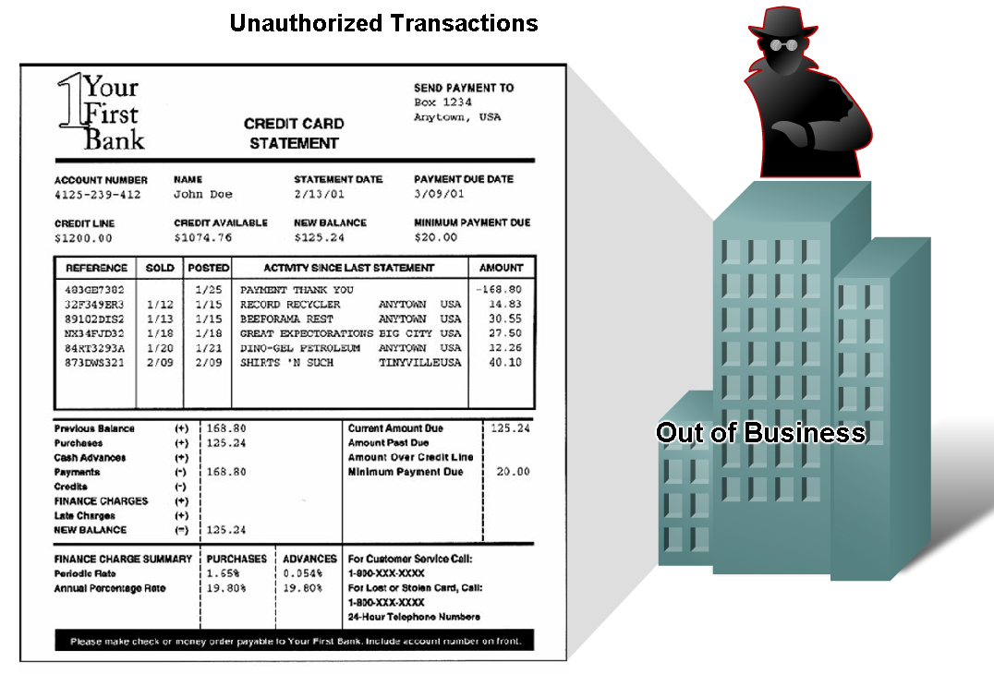
Network Architecture Characteristics
Describe why networks must be secure

Slide 41
Network Security
Consequences of a network security breach could include:
Network outage that prevents communications and transactions occurring, with consequent loss of business
Misdirection and loss of personal or business funds
Company intellectual property (research ideas, patents or designs) that is stolen and used by a competitor
Customer contract details that become known to competitors or made public, resulting in a loss of market confidence in the business

Slide 42
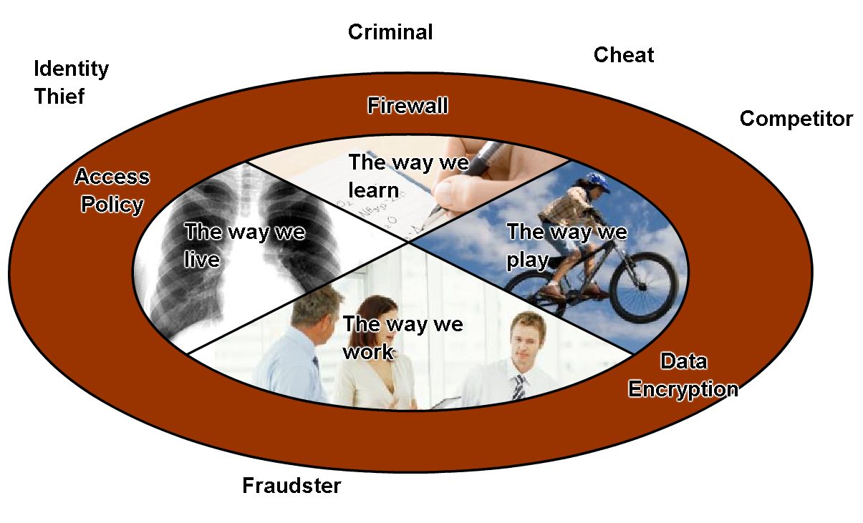
Network Architecture Characteristics
Describe basic measures to secure data networks
  Ensure confidentiality through use of
    User authentication
    Data encryption
  Maintain communication integrity through use of
    Digital signatures
  Ensure availability through use of
    Firewalls
    Redundant network
    architecture
    Hardware without a single
    point of failure

Slide 43
Ensuring Confidentiality
Data privacy is maintained by allowing only the intended and authorized recipients - individuals, processes, or devices - to read the data.
Having a strong system for user authentication, enforcing passwords that are difficult to guess, and requiring users to change them frequently helps restrict access to communications and to data stored on network attached devices.
Where appropriate, encrypting content ensures confidentiality and minimizes unauthorized disclosure or theft of information.

Slide 44
Maintaining Integrity
Data integrity means having the assurance that the information has not been altered in transmission, from origin to destination. Data integrity can be compromised when information has been corrupted - wilfully or accidentally - before the intended recipient receives it.
Source integrity is the assurance that the identity of the sender has been validated. Source integrity is compromised when a user or device fakes its identity and supplies incorrect information to a recipient.
The use of digital signatures, hashing algorithms and checksum mechanisms are ways to provide source and data integrity across a network to prevent unauthorized modification of information.

Slide 45
Ensuring Availability
Ensuring confidentiality and integrity are irrelevant if network resources become over burdened, or not available at all. Availability means having the assurance of timely and reliable access to data services for authorized users
Network firewall devices, along with desktop and server anti-virus software can ensure system reliability and the robustness to detect, repel, and cope with such attacks.
Building fully redundant network infrastructures, with few single points of failure, can reduce the impact of these threats.

Slide 46
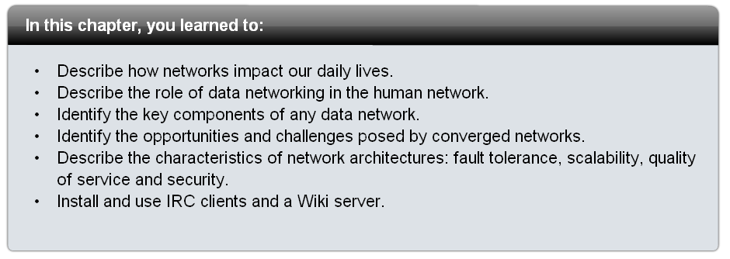
Summary

